Slide 1
LIME Deep drive
Raghu Prasad
9845547471
www.kaushalya.tech
CEO

Slide 2
Introduction
Raghu Prasad – BE, MS
Total of 30 years of experience
7 years as a lecturer in an Engineering College
23 Years into IT
Worked with companies like CISCO,CSC,ICICI,First Apex – NTT Data
Currently into Corporate training and consultancy
Worked with corporates and public sector
Service Offerings – In person/On-line/Corporate/Academic Institutes
Consultancy – Consultant to vendor of Atal Tinkering Lab/ECIL-ECIT, Incarnus – Healthcare Service Provider
Technologies – Java,Python,Web technologies,Java Script technologies (MEAN stack),IOT,Test Automation,Machine Learning,Artificial Intelligence,ERP,.NET,Cloud Computing,Devops,MLOps
Customers – ILinkDigital,Operative,Flatworld,IQVIA,Sony,Philips,L & T,NextGen,Incarnus,Aspire system,
NewHorizonCollege Of Engineering,NIE Mysore,Acharya College Of Engineering,SIT-Tumakuru,BGS-IT,Sindhi College,Malnad Enginering College,S B College of Management, REVA University,Nagarjuna Engineering College,Dayanand Sagar University,NIT-Imphal

Slide 3
Topics
LIME Deep drive

Slide 4
Introduction
LIME (Local Interpretable Model-agnostic Explanations)
LIME is an Explainable AI (XAI) technique used to understand why a machine learning model made a specific prediction for one instance.
👉 It explains predictions locally — for one data point at a time.
🧩 Key Idea
Instead of understanding the whole model:
🔍 LIME focuses on a small neighborhood near the input
It answers:
👉 “Why did the model predict THIS result for THIS input?”

Slide 5
Introduction
🏠 Example (House Price Prediction)
Suppose the model predicts:
💰 Price = $400,000 for one district
LIME explanation might say:
High median income → increases price
Coastal location → increases price
High population → decreases price
⚙️ How LIME Works (Conceptually)
Takes one data point
Creates many similar “perturbed” samples
Gets model predictions for those samples
Fits a simple interpretable model (e.g., linear model) locally
Uses it to explain the prediction

Slide 6
Introduction
📊 Why It’s Called “Model-Agnostic”
LIME works with any model, including:
✔ Linear models ✔ Random Forest ✔ Neural networks ✔ Deep learning ✔ Black-box models
📈 What LIME Produces
Typically shows:
🔺 Features supporting the prediction
🔻 Features opposing the prediction
Importance of each feature

Slide 7
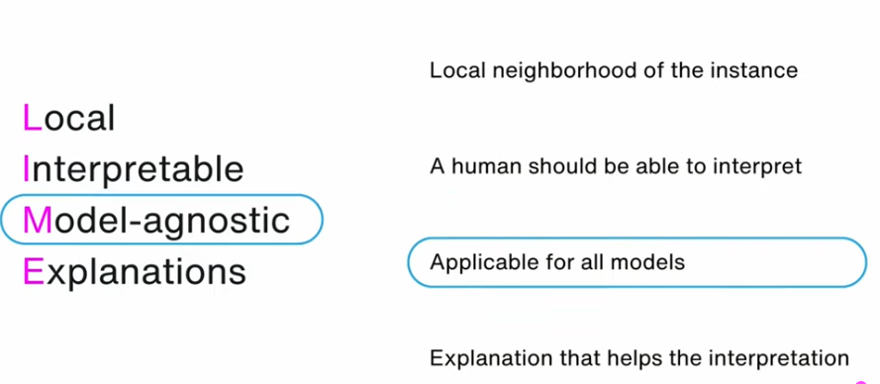
Introduction

Slide 8
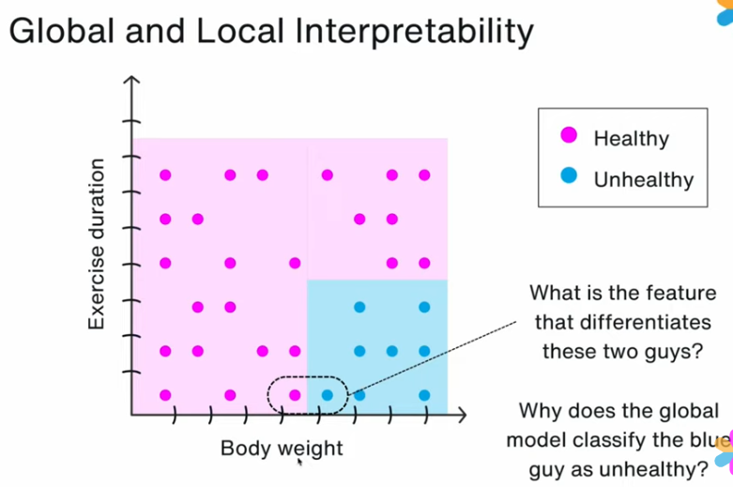
Introduction

Slide 9
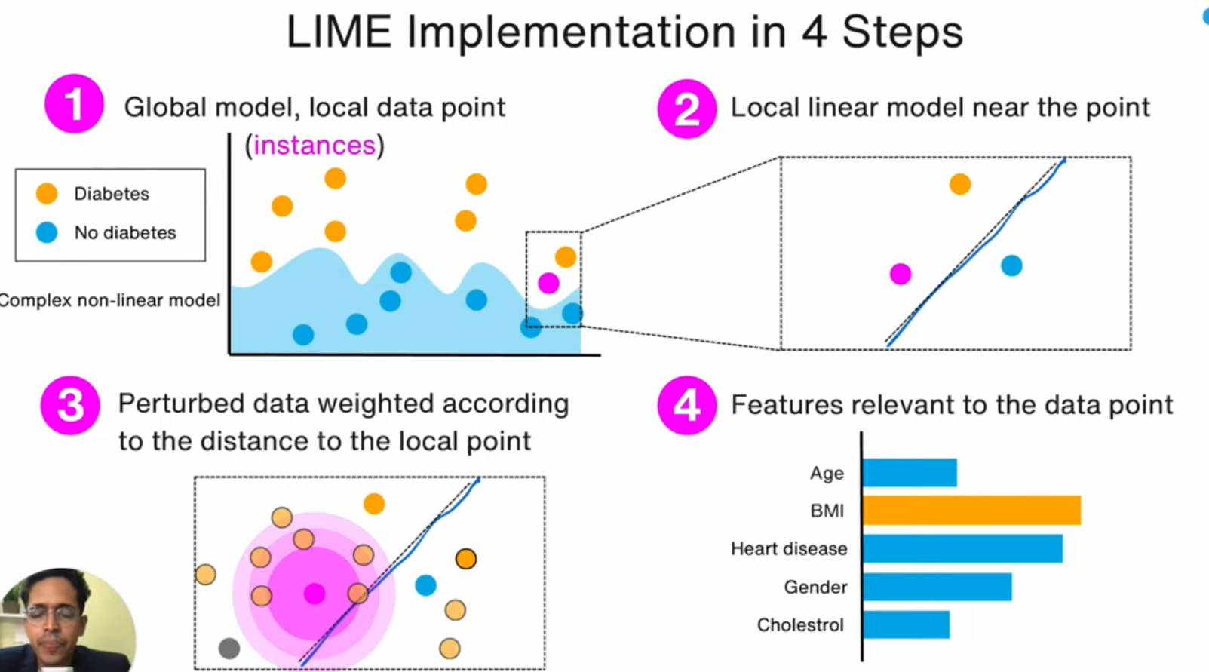
Lime Implementation

Slide 10
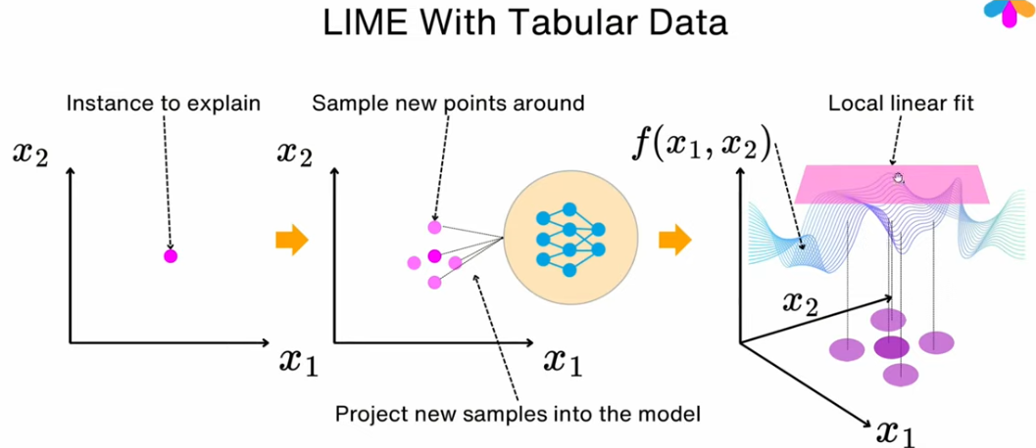
Lime Implementation

Slide 11
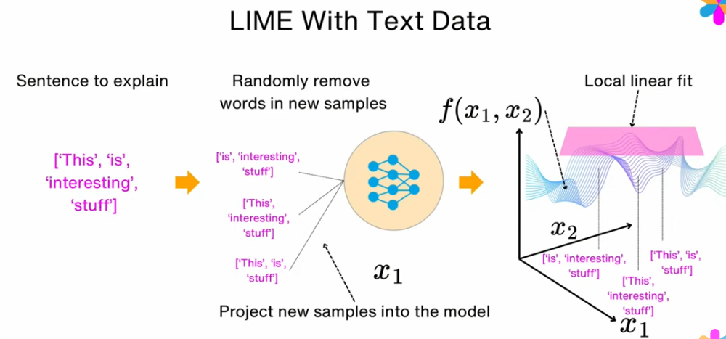
Lime Implementation

Slide 12
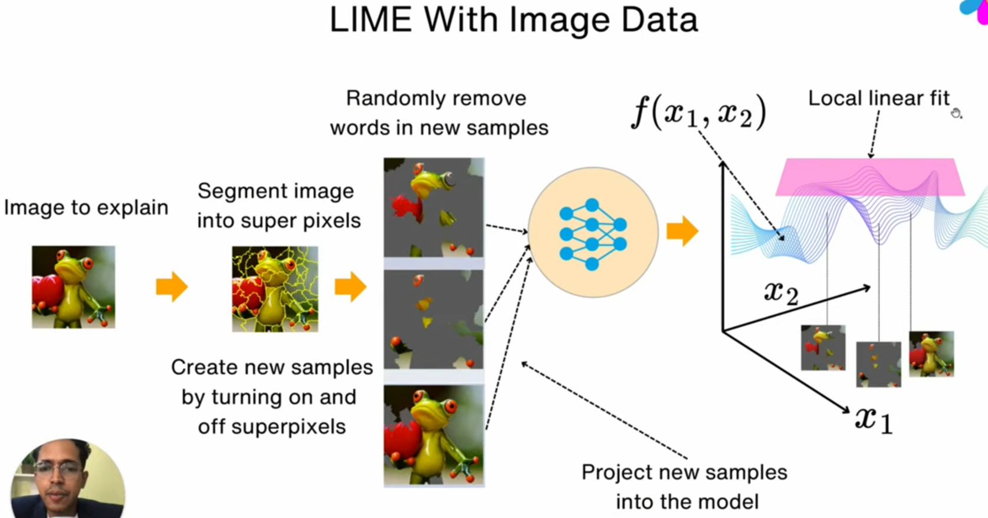
Lime Implementation

Slide 13
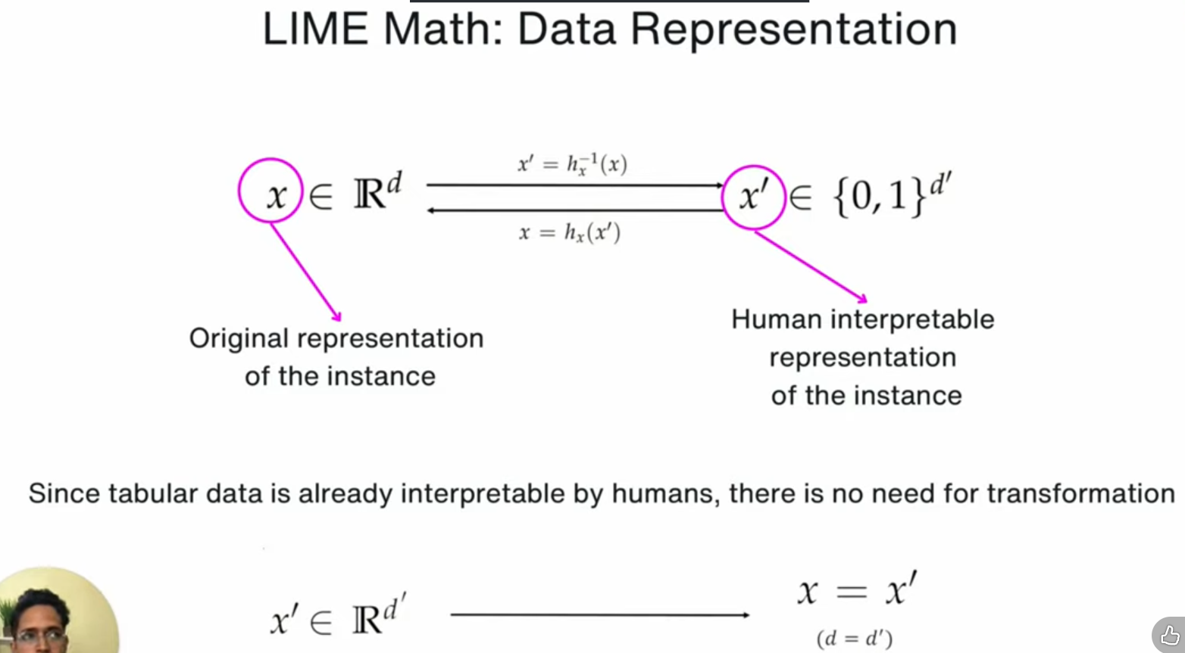
Lime Implementation

Slide 14
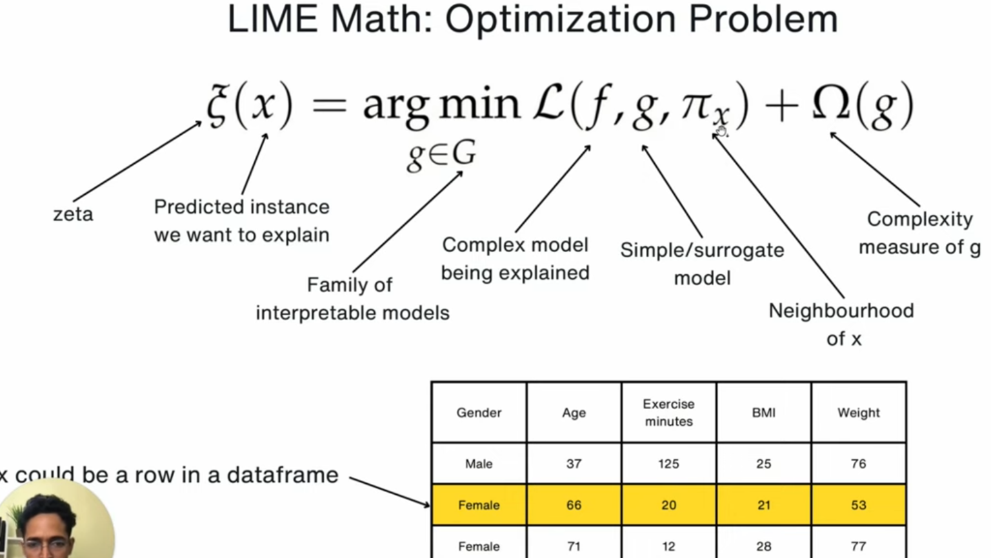
Lime Implementation

Slide 15
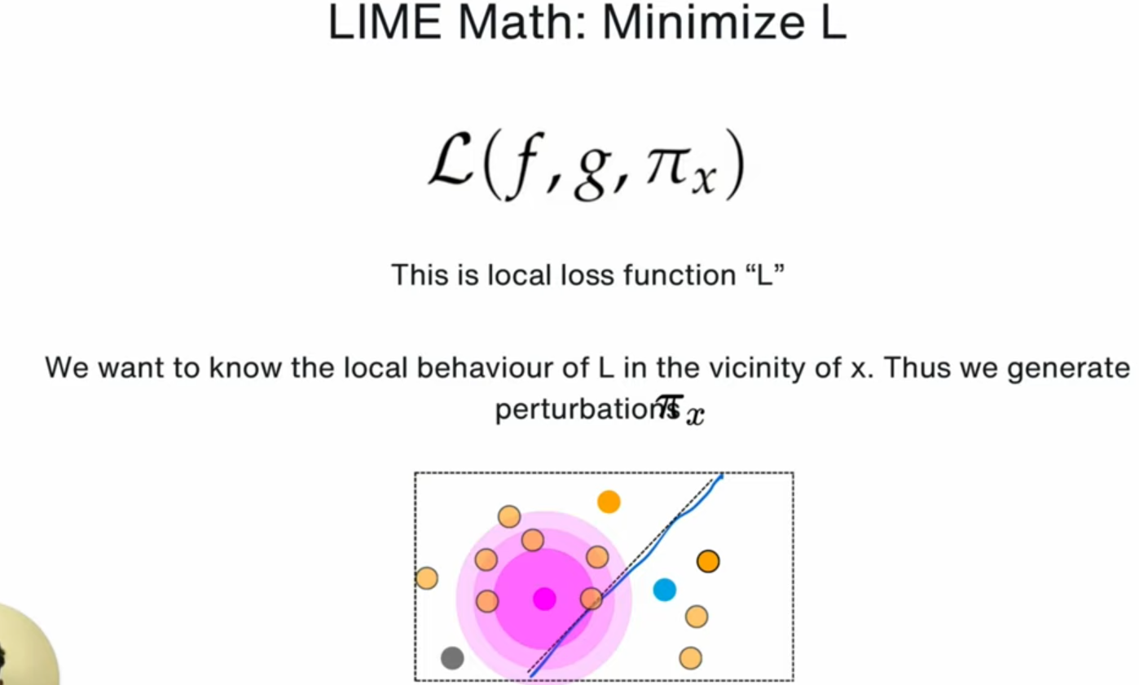
Lime Implementation

Slide 16
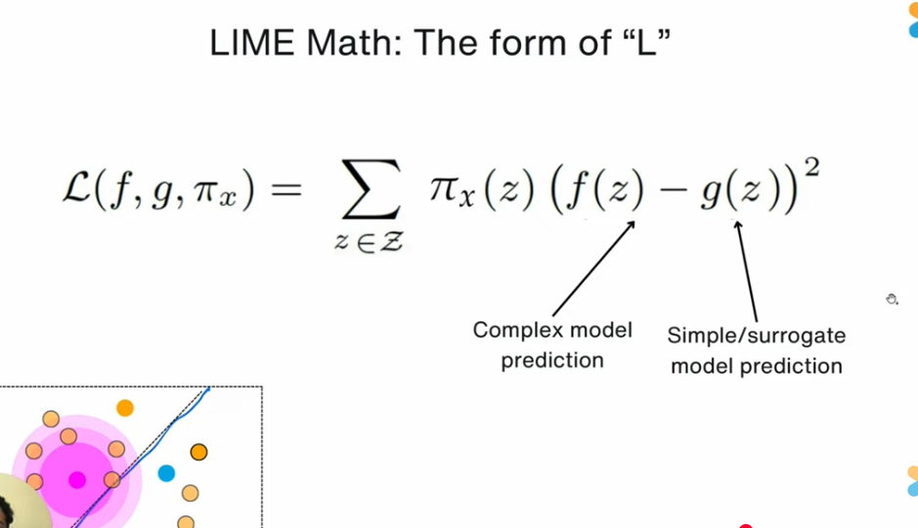
Lime Implementation

Slide 17
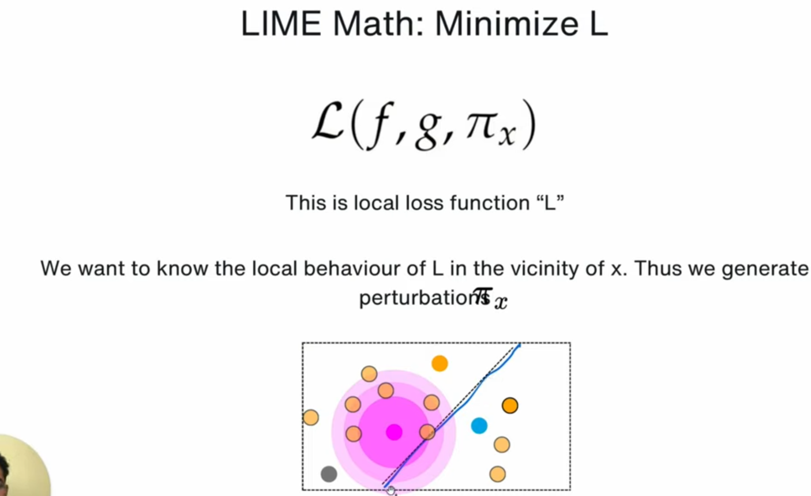
Lime Implementation

Slide 18
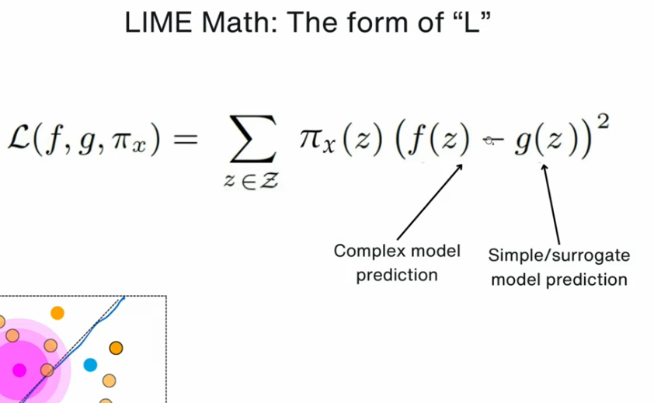
Lime Implementation

Slide 19
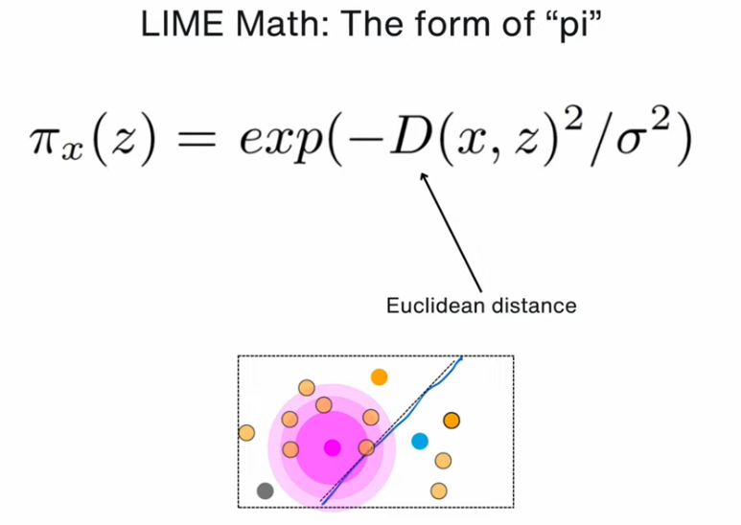
Lime Implementation

Slide 20
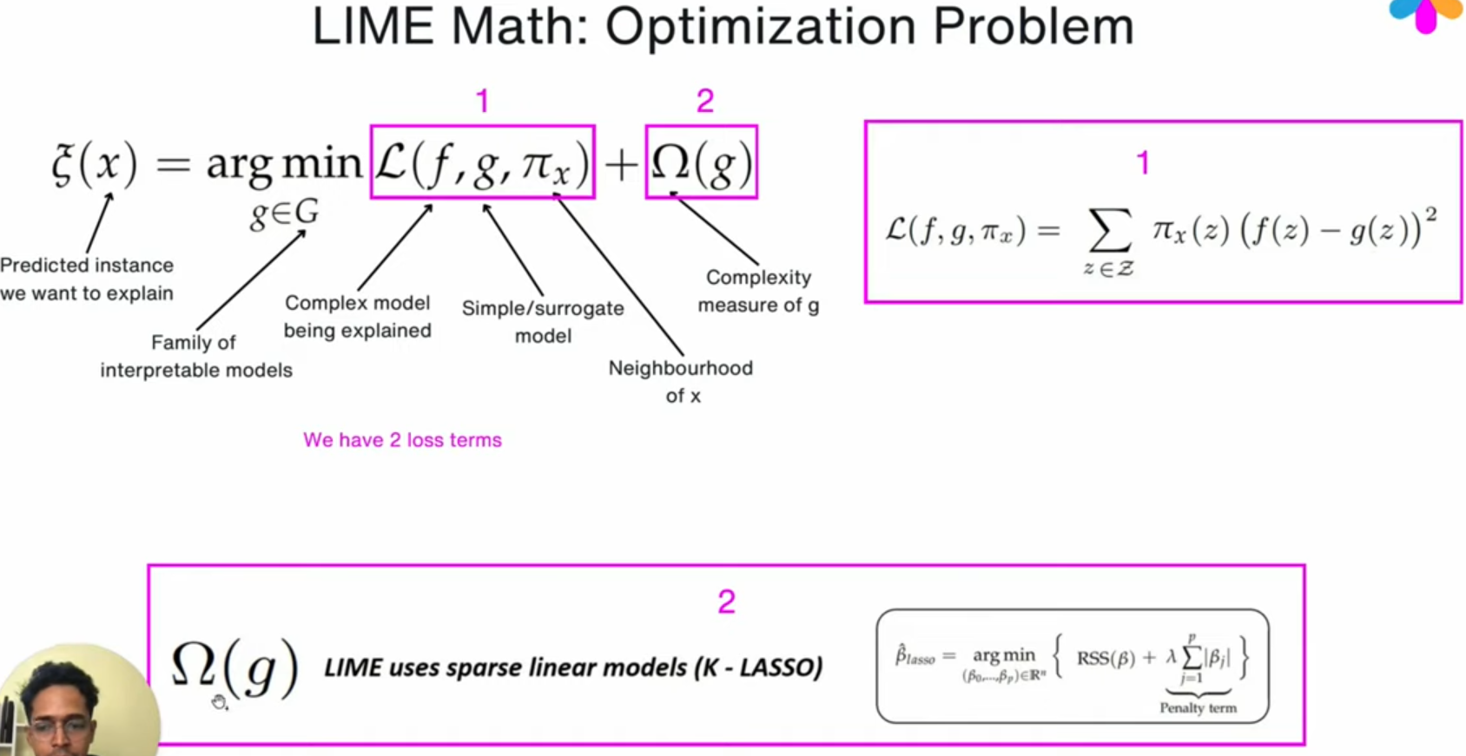
Lime Implementation

Slide 21
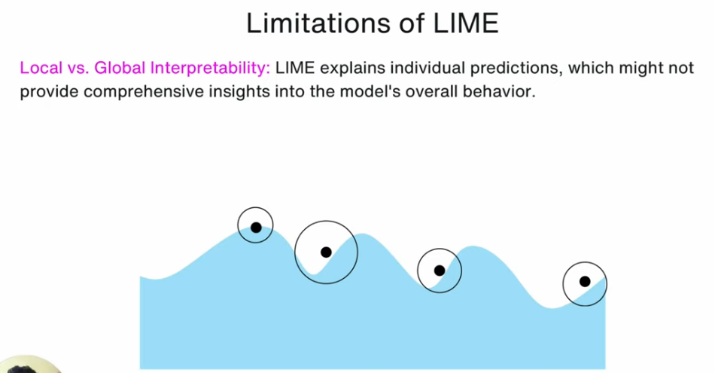
Lime Implementation

Slide 22
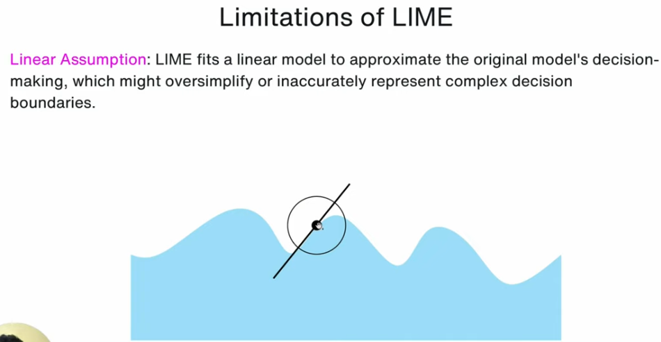
Lime Implementation

Slide 23
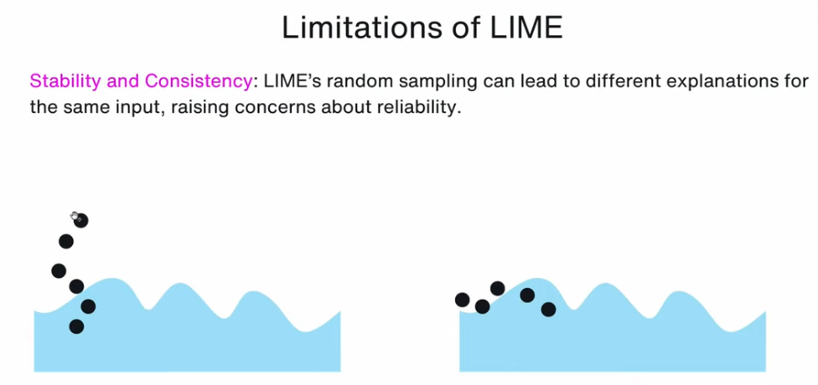
Lime Implementation

Slide 24
References
Paper: The original LIME paper- https://arxiv.org/abs/1602.04938 GitHub repo: https://github.com/marcotcr/lime Blog/Articles: 1) https://www.oreilly.com/content/intro... 2) https://newsletter.theaiedge.io/p/the... https://youtu.be/qQvC6FWlc-E?si=zaQ_GSoscg0z8sP6
Notes:
Linear Regression is highly interpretable

Slide 25
Thank You
Raghu Prasad
9845547471
www.kaushalya.tech

